Slide 1
Introduction to Electric and Electronics
Homework #4

Slide 2
Homework #4
Homework #4
Solve Problems 6.28, 9.9, 9.17, 10.4, 10.28
Submission within a week from day assigned. (Homework #4 is not assigned yet)

Slide 3
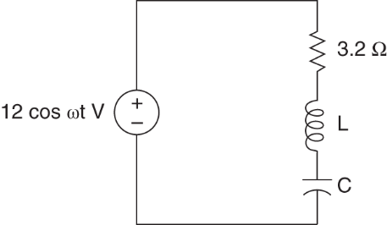

Homework #4
Problem #1
If the parameter for the RLC circuit are $ω_{0}=5000 rad/s$ and Q=30, determine the unknown circuit parameters. Figure P6.28

Slide 4
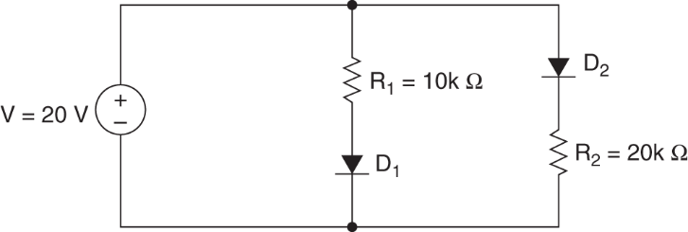
Homework #4
Problem #2
Assuming ideal diodes, calculate the current through (a) D₁, (b) D₂, and (c) V, the source.
Figure P9.9

Slide 5
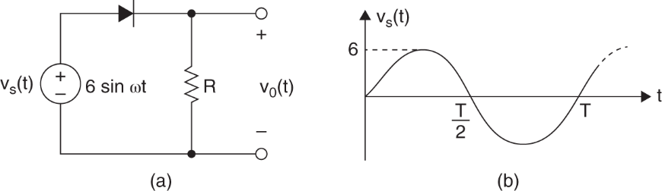

Homework #4
Problem #3
Draw the output waveform for the voltage $v_{o}(t)$.
Figure P9.17

Slide 6
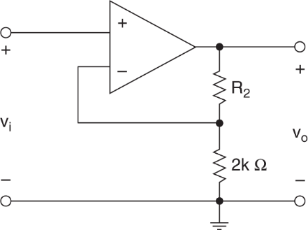
Homework #4
Problem #4
Determine the value of R2 that will produce a gain of at least 41.
Figure P10.4

Slide 7
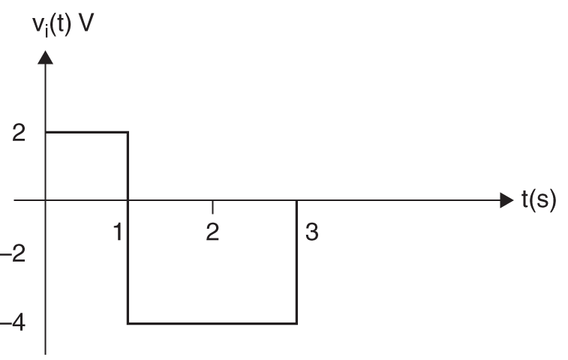
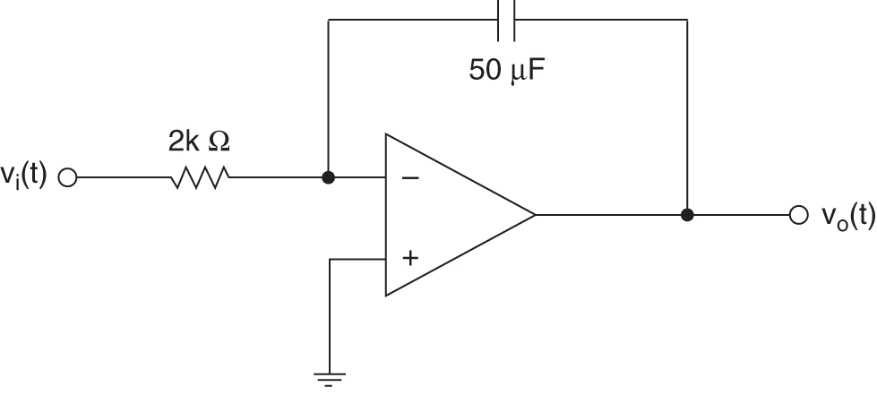
Homework #4
Problem #5
5. Determine the waveform of the output voltage if v_{i}(t)=0 at t=0.
Figure P10.28

